Slide 1



A Digital Engineering Company
CONSULTING | DIGITAL SOLUTIONS | IT SERVICES
Solution Architecture
REVAMP
A Division of Gateway Group
WWW.THEGATEWAYDIGITAL.COM
Note: Client logo image is an integral part with sole client ownership.

Slide 2
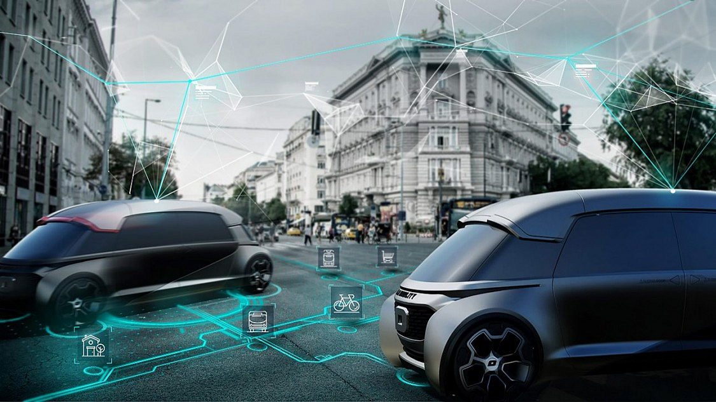
1.
Architectural system evaluation
Define the technology stack for all platform components
2.
Agenda:
3.
Define a collaboration framework
Defines architecture of the Tuv application
4.
Solution construction or Modification existing system
5.
6.

Slide 3
Solution Architecture
OUR ANALYSIS

Slide 4
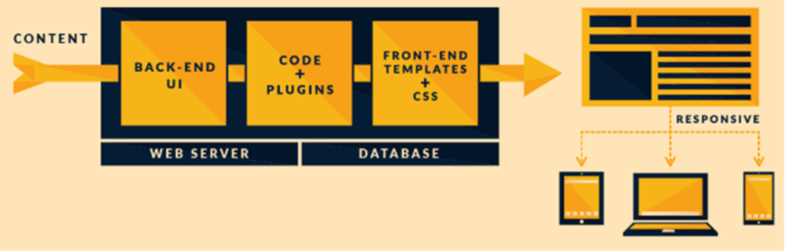
Traditional BackOffice
Notes:
Consumer
Infotainment Interface: Most of OEMs are now providing infotainment interface in all latest model cars. In-Car Infotainment Solution converges vehicle data, sensor information, telematics, multi-media, cloud/backend servers, informational and entertainment intelligence into a single platform to enable the Next ERA of Connected Cars.
Car Sharing: A dynamic & instant carpooling solutions for your daily home-office-home commute. User can share their car with another while travelling alone it would be save cost, reduce traffic congestion, earn money and make new friends daily!
Delivery: Book Truck, send goods & track the delivery status
EV Charging: Search nearest charging station for Electric vehicle charging. Locate charging station, book slot & pay online using mobile app.
Smart Parking: View informative maps of parking lots availability as per users current location, Check daily & monthly parking rates, set parking timer to avoid overstaying, overpaying or getting a ticket.
On Demand Rentals: User can book a car in rent using hourly, daily, weekly, or monthly rental options. This service makes hiring experience is hassle free as the tariff always includes free fuel, insurance, and taxes. User can use this service around town OR while going out of station for a long weekend.
Diagnostics: User can get location management, driver behavior analysis, vehicle health management, trip tracking, trip tagging, roadside assistance, a fuel finder etc. Ex: https://play.google.com/store/apps/details?id=com.greenlight.zubie&hl=en
Driver Behavior: This types of solutions includes driving behavior analysis using mobile camera, GPS & sensor. The application can give alerts to user such as: forward collision warning, headway monitoring warning, lane departure warnings, traffic alerts, speed sign detection etc. https://play.google.com/store/apps/details?id=com.picitup.iOnRoad.pro&hl=en
Ride Hailing: Taxi booking service through the mobile application as per your pick up & drop up location. Ex: Uber
Ride Sharing: User can avail this service by sharing their taxi with another passenger looking for a taxi on the same way.
Enterprise
Routing Optimization: This types of solutions are providing shortest & optimized route to cover all your visits as per your requirement. If you have to pick multiple parcels/visit multiple client in a particular duration it will provide you optimized route to cover all your visits.
Fleet Tracking & Asset Management: Enterprise applications to track fleet & assets.
Telematic Service Providers: Enterprise solutions which allow their customers to track vehicle data.
Security: Used for enterprise data security
Smart Cities: This section includes various types of application for smart cities. Ex: Manage change points, manage Street lights of cities etc.
Usage-Based Insurance: It provides mile-based auto insurance is a type of vehicle insurance whereby the costs are dependent upon type of vehicle used, measured against time, distance, behavior and place.
Distribution/Logistics: Enterprise applications to manage end to end logistics system.
Apps - Location - Data
Infotainment Applications: Entertainment solutions which can access the latest news, sports, social media newsfeeds, restaurants, hotels and entertainment podcasts etc. instantly as per the location.
Big Data: Extremely large data sets that may be analysed computationally to reveal patterns, trends, and associations, especially relating to human behavior and interactions.
App Platform: A single platform can allow user to get location management, driver behavior analysis, vehicle health management, trip tracking, trip tagging, roadside assistance, a fuel finder, and more. https://play.google.com/store/apps/details?id=com.greenlight.zubie&hl=en
Driver Behavior: This types of mobility solutions functionality includes driver behavior analysis, vehicle health management, trip tracking, trip tagging, roadside assistance, a fuel finder, reminder, alerts etc.
Location/Navigation: This types of applications allow user to locate places on map, display route & navigate to the location.
Internet of Things
Autonomous: An autonomous car is also known as a driverless car, self-driving car etc. This type of vehicle is capable of sensing its environment and navigating without human input. Autonomous cars use a variety of techniques to detect their surroundings, such as radar, laser light, GPS, odometry and computer vision. Advanced control systems interpret sensory information to identify appropriate navigation paths, as well as obstacles and relevant signage. https://en.wikipedia.org/wiki/Autonomous_car
Wearables: These are he smart electronic devices that can be worn on the body as implants or accessories. The devices has capable to track various types human activity related data through software, sensors & notify user through internet connection. https://en.wikipedia.org/wiki/Wearable_technology
Sensors/Hardware: Various types of hardwares / sensors will help user to drive safely & provide alerts to the driver. Ex: https://play.google.com/store/apps/details?id=ru.roadar.android&hl=en
Heads Up Display: It includes Advanced Driver Assistance Systems, Active Driver monitoring, Autonomous Driving, Telematics for connected car solution. Ex: https://www.i4drive.com/solutions
Vehicle to Infrastructure: These are the solutions used to connect vehicle with infrastructure such as traffic light, weather, hospital, parking etc. Ex: http://www.sensysnetworks.com/
Infotainment Embedded: This section includes embedded solutions connected with mobile apps to help drivers while driving. navigating to a destination and talking hands-free, listening to music & switch to another driving app with the voice command.
Automatic Dongle: Various Dongle based solutions to track driver activity, manage trip, get alerts etc. https://xgear.io/

Slide 5





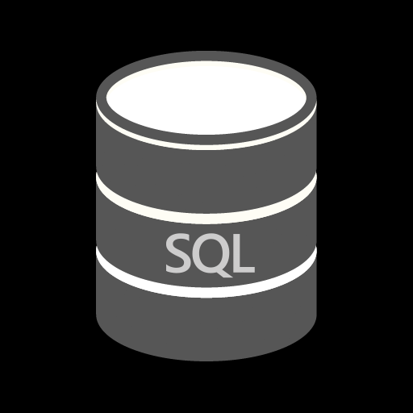
Current Technology
FRONT END
BACK END
WCF
DATABASE

Slide 6

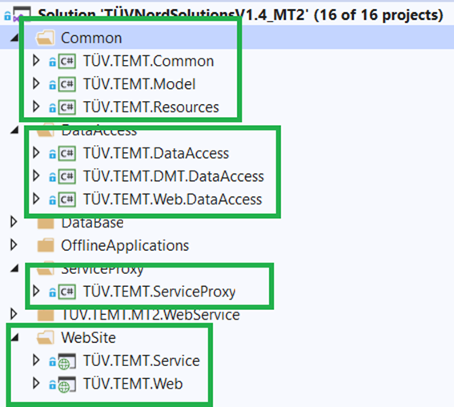
Current Project Architecture
Web
Logger, Cache
Service Proxy
Model
WCF
Resources
Data Access
(Manager, Repository)

Slide 7
Triggering Factors
Developed with the older technology stack which required more efforts and time to upgrade to the latest version as direct upgrade is not possible due to the MVC framework.
Back-End section developed in WCF. There are a lot of pre-used set of libraries
WCF allows a single consistent access to windows communication technologies therefore it’s not possible communicate with mobile device.
Real time web communication isn’t support by current framework and technology.
Improvement area at Database level Ex: store procedure, View level
It is too big and complex for modular development.
Security: Current Development we have directly access back-end end points.
Deployment: Website deployment on IIS level, need to upgrade technology for cloud deployment and cloud technology benefit.
Development on Monolithic Architecture and layer wise dependency, library reference problem and it’s not nugget based manually need’s to add library reference.
Required more effort, time and complexity for decoupling the module from current implementation to modular implementation in true manners

Slide 8
Triggering Factors
Database logging does not provide actual picture in terms of application monitoring and take time to identify the root cause.
Current implementation of the exception logging and tracing required to be changed from the database logging.
This will required additional tool to keep on monitoring for application infrastructure
Modules are tightly coupled with each other and dependency injection is not implemented correctly.
Even though dependency injected in constructor it is using new keyword and creating new instances of the class and not managed by NuGet.

Slide 9
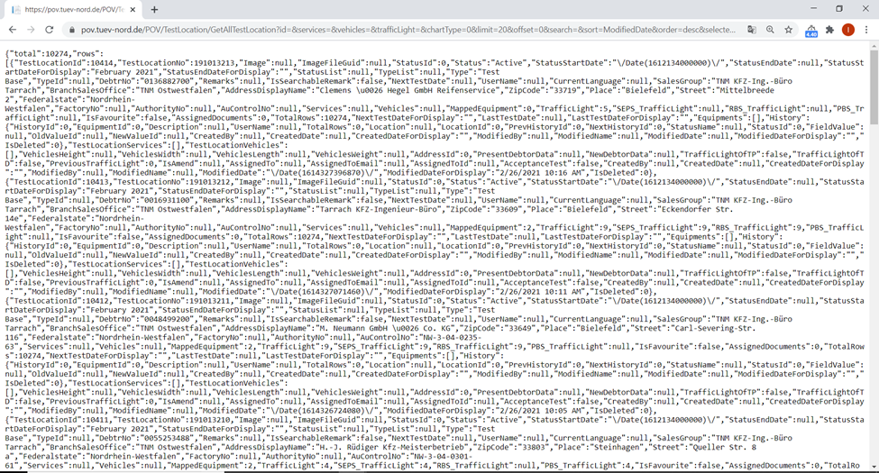
Security
Data Access: Back-end WCF Service data access through browser and WCF End directly access without any authentication
URL: https://pov.tuev-nord.de/POV/TestLocation/GetAllTestLocation?id=&services=&vehicles=&trafficLight=&chartType=0&limit=20&offset=0&search=&sort=ModifiedDate&order=desc&selectedIds=

Slide 10
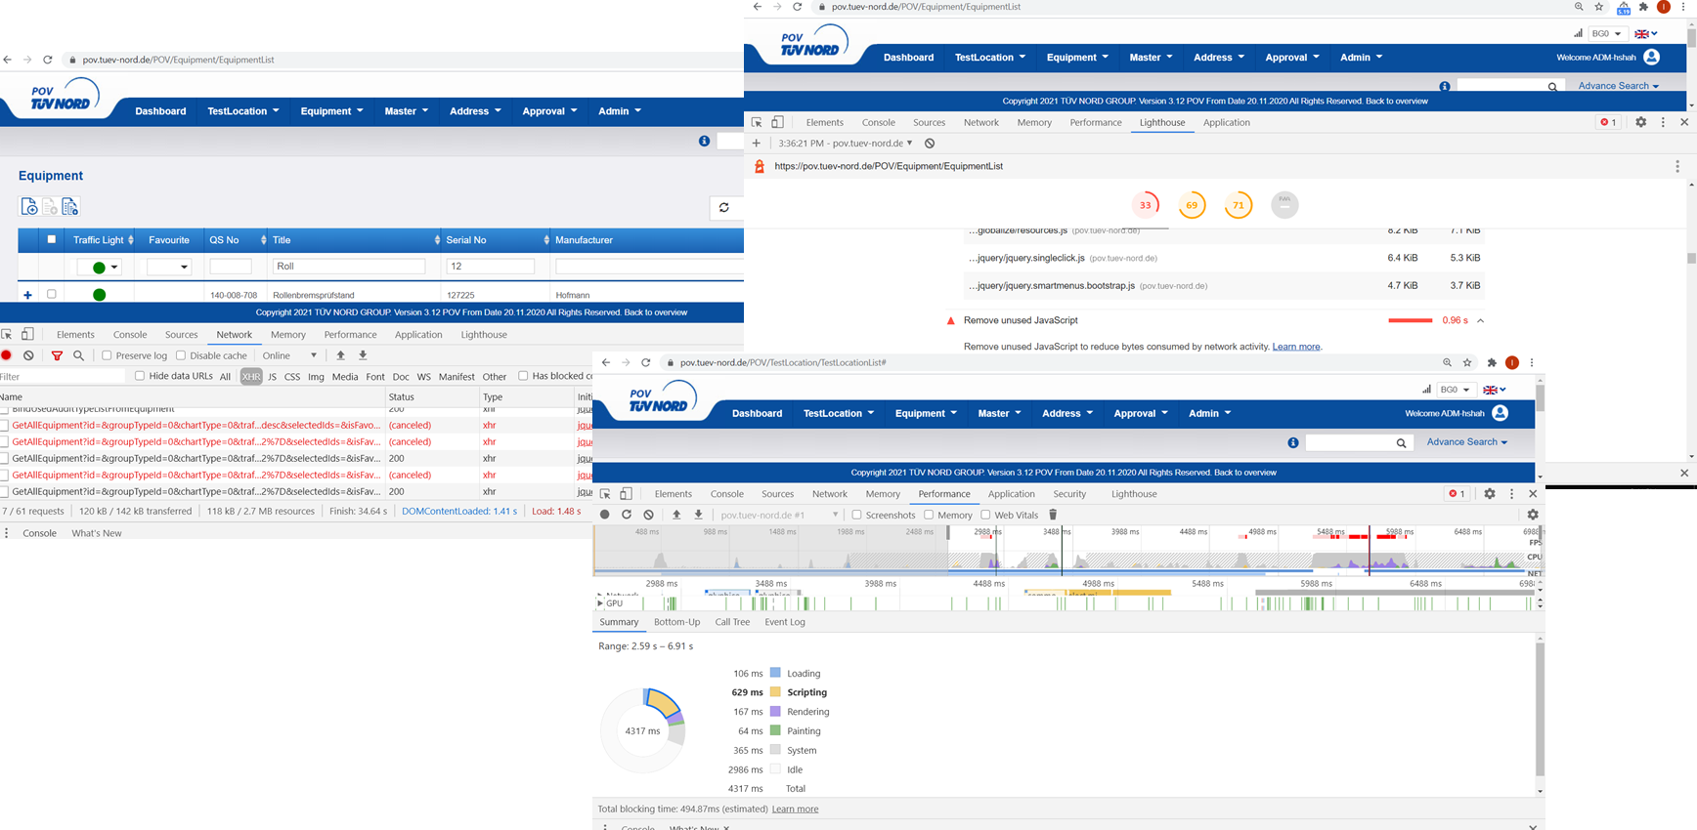
Option1: Optimization on existing project

Slide 11
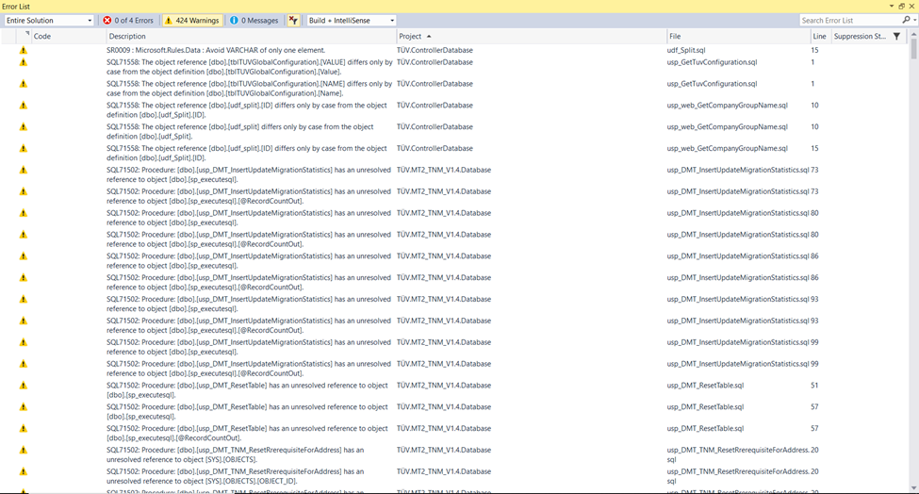
Microsoft Warning

Slide 12
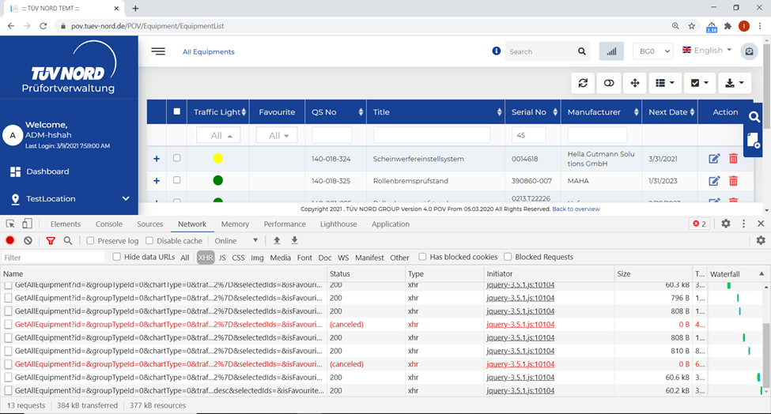
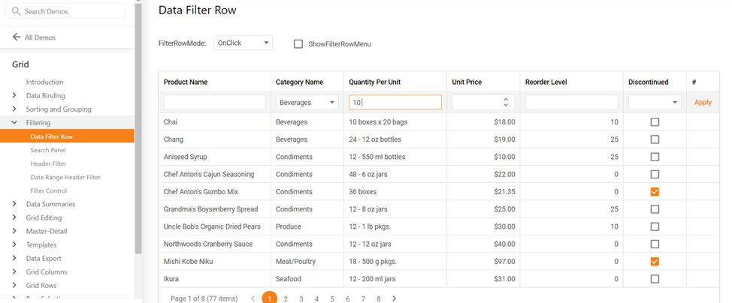
Searching Section
Problem Performance: optimize loading time (list grids)
As discussed the loading time for all list grids is in worst case too long for a few colleagues. Because they are inserting a filter word at the column, waiting, once the list is loaded they are searching at the 2nd columns. in worst case there is misspelling, then they're waiting to see "oh, I miss spelled a word", you understand :) it takes so long is this scenarios
Loading test equipment list and test location list takes in general too long.
We definitively have to think about how we can reduce it.
Maybe we need to change the logic how we are loading the data.
Initial loading time of test location list grid: more than 20 sec.
Solution : https://demos.devexpress.com/aspxgridviewdemos/Filtering/FilterRow.aspx

Slide 13
Real time data (refresh values) | SignalR
Real time data (refresh values) | SignalR
the values should be updated at all users.
If user A opend one tab and keep it open for e.g. 3 hours and within this time user B is updating
a value of the respective test equipment, it should be directly reflected to users A page.
Solution:
Develop your application on latest technology to .Net Core 5.0 with SignalR

Slide 14
Proposed Architecture

Slide 15
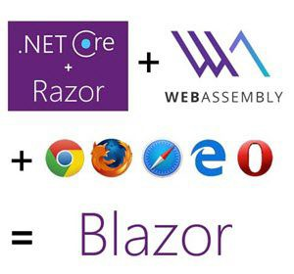
















Option2: Tools & Framework
FRONT END
Code Analysis
Or
BACK END
Code
Smell
API
Azure AD
Blob Storage
Azure Key Vault
Microsoft Azure
DATABASE
API TESTING

Slide 16
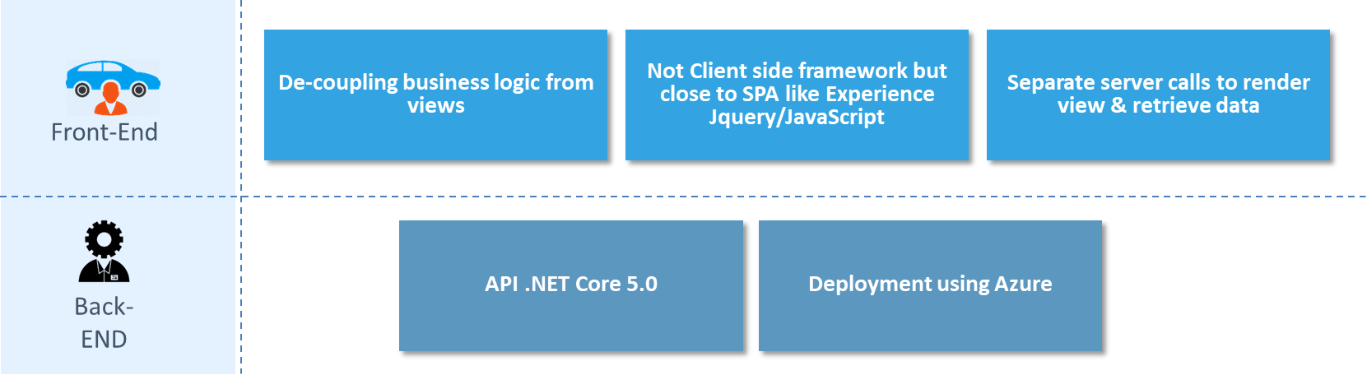
Front-End / Back-End

Slide 17
Communication Channel

Slide 18

Architecture
.NET Core Web API
Cross Cutting .
Authorization
Api Controller
API Method 1
Exception
Constructor
API Method 1
Business Model
or
Equipment Model
Common Model
Business Logic
BACK END
Constant
Business Manager
iBusiness
Business Method 1
Business Method 1
Constructor
Business Method 1
Logging
FRONT END
Data Access
iData
Data
Data Method 1
Constructor
Data Method 1
Security
Data Method 1
Database Framework
iRepository
Repository
Repository Method 1
External Services/ Third Party Integration
Helpers
Constructor
Repository Method 1
iServices
Services
Service Method 1
Repository Method 1
Constructor
Service Method 1
Database
Service Method 1

Slide 19
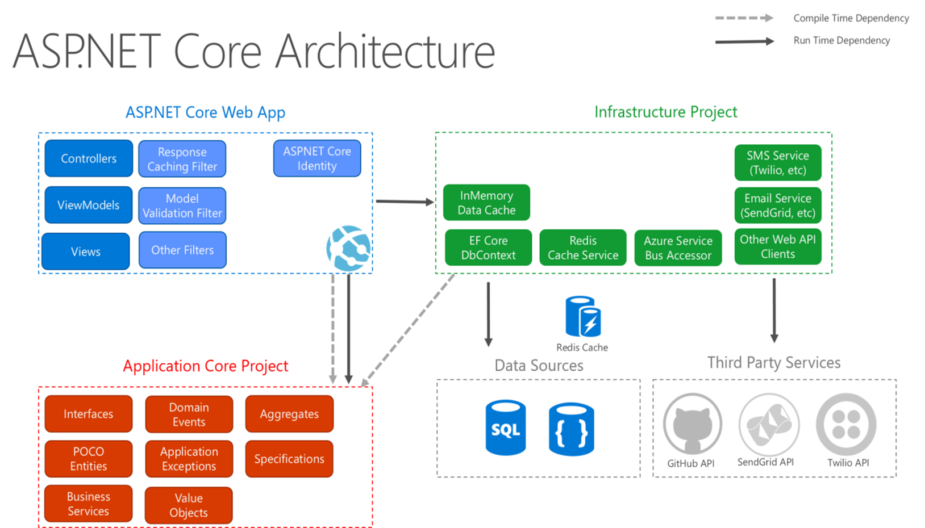

Slide 20
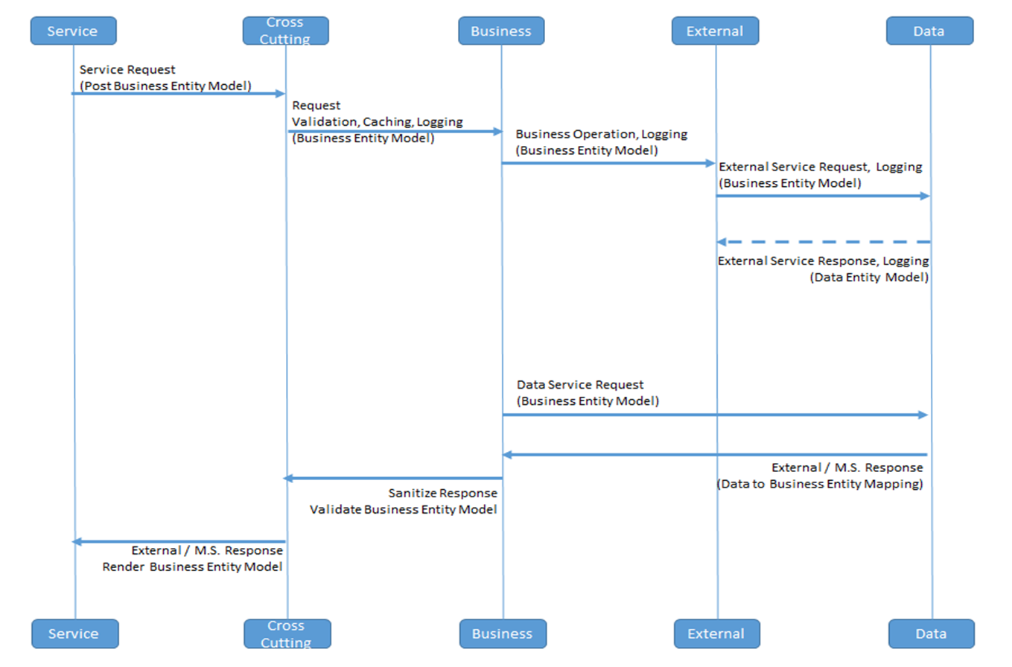
Request Flow

Slide 21



.NET Core Architecture PROs
Provides Agility – Design, Development & Deployment
Easier to scale service. It is possible to scale out individual areas of the application
Better fault isolation
Use the best approach
Deliver value faster
Easier to maintain and deploy
Enables us to choose latest technologies
Supports continuous integration and continuous delivery
Easier to understand
Facilitates code reuse
Easier to integrate with other systems
Enhanced security
Token-based authentication using Oauth2
No more cookie / session based authentication
Release dependency
Moving from monolith to API
Reduce downtime
Moving from application level to module level
Compatible with TDD / CI-CD
Platform Independent Deployment
Better Performance & Response Time
Improve
Performance
Code Reuse
Reduce Downtime

Slide 22

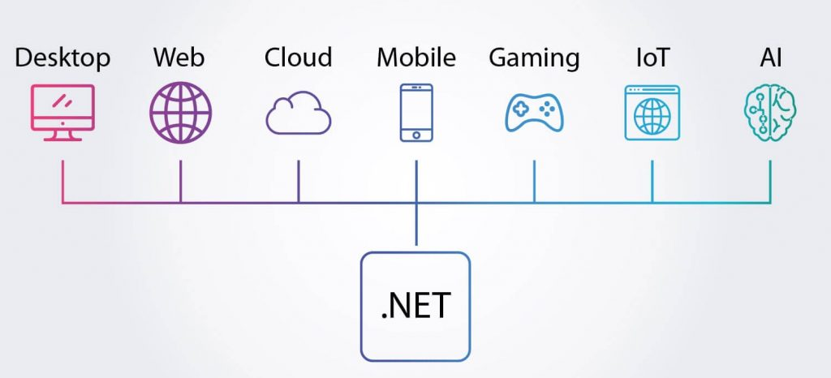
.NET CORE
Cross Platform
Open Source
Code Reusability
Support Parallel development
Allow very quick communications
Faster Time To Market
Transparency & Reliability
Freedom from Lock-In
Mature Framework
Secure
Stable
Easy Maintenance
Cost Effective
Easy Mechanism for Authentication, Authorization & Attack Prevention
Performance Ready
Support
With the re-compilation it optimizes the code directly
Created by Microsoft
Large Developer Community

Slide 23
Approach Benefits
Each page of the module will be built with component-based approach in frontend
Common component to be converted in to the Directives.
Each layer of client-side application will be loosely coupled. Easily injectable.
Services can be injected as and when required.
Each layer will have their own responsibilities.
Help increase testability.
Business model and data models will be different.
Single point of communication from Data Service to API.
Single point of communication for requests and responses via external service layer.
Data validation on Controller.
Data Mapping in Data Access Layer.
Business Entity to travel up to data access class. And Data Entity will be restricted up to data access.
no release dependencies in deployment for both (backend and frontend)

Slide 24
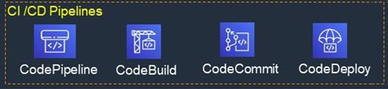
Delivery - CI/CD

Slide 25
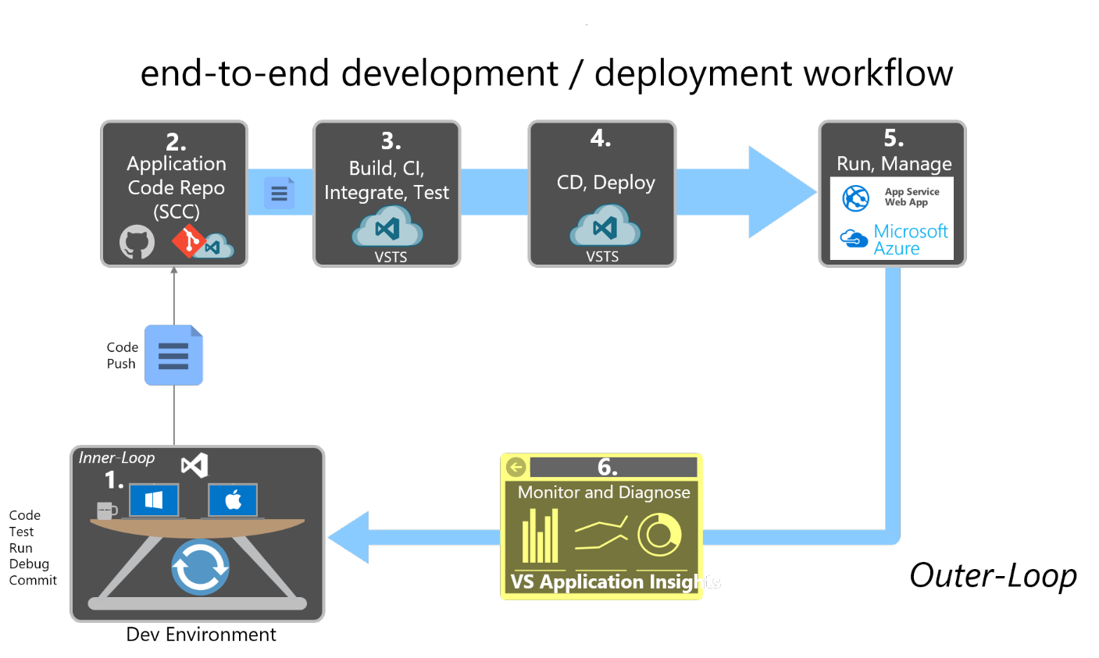
Notes:
https://docs.microsoft.com/en-us/dotnet/architecture/modern-web-apps-azure/development-process-for-azure

Slide 26
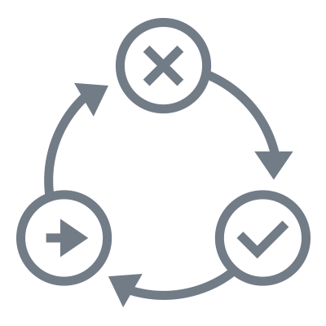
Delivery – TDD
Write
Test
End – to – End
Tests
Refactor
Test
Fails
Integration
Tests
TDD
Unit Tests
(Property based
Testing)
Test
Passes
Write
Code

Slide 27
Why we selected Angular
Easy Manipulation: Angular's MVC structure allows applications to be divided into three interconnected components, thus they are easier to manipulate, once learned.
Two-way data binding: Any changes you make to the model affect the view, and vice versa.
Progressive Web Apps and Hybrid Mobile Apps: Angular 8, in combination with Ionic 2, is a perfect tool for building hybrid apps. The same technology stack can be used for progressive web app development. Angular 8 (and up) comes with a mobile toolkit which makes developing mobile apps extremely easy and quick.
Framework: As Angular is a framework it includes standardized, pre-written code, which makes the development of certain functionalities easier and faster.
Scalable: Angular is easy to scale thanks to its design as well as a powerful CLI.

Slide 28

Software Quality Attributes
Resiliency
Ability of an application to react to problems in one of its components and still provide the best possible service.
Testability
Ability of an application to support testing.
Usability
Usability is the degree to which a software can be used. Software should be easy to use.
Interoperability
Ability of the application to interact with other systems.
Reusability
Ability of a software functionality to be used inside other software. Code reuse.
Debug ability
Ability of the software to easily find what's wrong with a piece of software, whether it's through logs, statistics or debugger tools.

Slide 29

Thankyou. Let’s Connect Soon
Corporate Headquarters
The Netherlands
Maria Montessorilaan 5, 2719 DB Zoetermeer
Tel: +31 (0) 79 3200 980
India
B/81, Corporate House, Ahmedabad - 380054. India.
Tel: +91 79 2685 2554 / 55 / 56
E-mail: gateway@thegatewaycorp.com
Serving Clients in 16 Countries
BELGIUM
FRANCE JAPAN
SWEDEN
CANADA
GERMANY
NORWAY
THE NETHERLANDS
DENMARK
ICELAND U.K.
UAE
FINLAND
INDIA
SOUTH AFRICA
U.S.A

